Slide 1
Problems with the Use of Student
Test Scores to Evaluate Teachers
Edward Haertel
School of Education
Stanford University
California Educational Research Association
Anaheim, California
December 1, 2011
Notes:
I want to thank Roger Yoho for inviting me here to speak to you this morning. There’s been a lot of attention, and a lot of controversy, surrounding the use of so-called “Value-Added Models” for teacher evaluation. I’ve spent some time digging into the literature to try and understand how these things work, and I’m happy to share with you some of what I’ve learned.

Slide 2

Economists, statisticians, psychometricians, and policy experts all worked together to write this EPI Briefing Paper, released in August 2010.
Thanks to my co-authors for contributing to my own education on this important issue.
Notes:
I’ve been in this business for 30 years, and I’ve seen a lot of ideas about how student test scores might be used to improve education—Program evaluation, criterion-referenced testing, performance assessment, minimum competency testing, teacher certification tests, school accountability systems, high school exit examinations, and now value-added models for teacher evaluation. There was some good thinking behind each of these ideas, but I think it’s fair to say that most of them were pushed too far, and that all of them fell short of their proponents’ expectations. I think we all agree that if Value-Added models worked the way we wish they worked, they could be really useful. But like so many other educational fads and innovations, these models have been seriously oversold, and they have some pretty serious problems.

Slide 3
Framing the Problem
Teacher quality is central to student success
There is broad consensus that teacher support and evaluation need improvement
  Teachers need better support and targeted assistance to identify and remediate deficiencies
  Principals are challenged by the sheer number of teachers they must monitor and evaluate
  Contracts and labor laws make teacher dismissal difficult
Notes:
Policy makers are frustrated with stagnating student achievement and seemingly intractable achievement gaps. The solutions that have been tried don’t seem to be working. Current policy rhetoric calls for a shift of focus from teacher qualifications to teacher effectiveness, from qualified teachers to quality teachers.

Slide 4
Framing the Problem
Looking directly at student outcomes to judge teachers has intuitive appeal
  Test scores are already used to evaluate students and schools, why not teachers?
  Numbers appear objective and impartial
  Complex statistical models lend an aura of scientific rigor
  Value Added Models (VAMs) are actively promoted as scientific tools that can distinguish good teachers from bad
Notes:
It's easy to understand why these new statistical models would have a lot of appeal.

Slide 5
VAM Logic
If prior achievement is “held constant” by building prior-year test scores into a statistical model, then student score gains should reflect teacher effectiveness
  The difference between last year’s score and this year’s score represents the “value added” by this year’s teacher
Notes:
A lot of factors influence students’ test scores, some random, some not. Random factors are unpredictable influences that average out to zero. These will tend to wash out as we average across a lot of students. Nonrandom factors are things that on average, lean favorably for some teachers and unfavorably for others. These will persist when we average across the students a teacher works with. What a VA model has to do, then, is to disentangle the effect of the teacher from all those other nonrandom factors. Some but not all of those other factors are reflected in students’ prior achievement.

Slide 6
Two Simplified Assumptions
Teaching matters, and some teachers teach better than others
There is a stable construct we may refer to as a teacher’s “effectiveness”
  that can be estimated from students’ test scores
  that can predict future performance
Simplified to
Notes:
I suppose I could have said “Simplifying,” but “simplified” seemed like a better word to convey my meaning here.
[After second bullet] A construct is an underlying variable—An attribute that cannot be observed directly, but can be inferred from observables. In building psychological theories, we regard constructs as working hypotheses that must be supported by theory and research. This “effectiveness” construct may not hold up very well.

Slide 7
Two Simplified Assumptions
Student achievement is a central goal of schooling
Valid tests can measure achievement
Achievement is a one-dimensional continuum
Brief, inexpensive achievement tests locate students on that continuum
Simplified to
Notes:
Since I’m a psychometrician, I could spend a lot of time on just this one slide.
I’ll just say that it’s very difficult to take two test scores from a year apart, on two different tests aligned to different grade level content standards, and use those two scores to figure out how much a student has learned over the course of the year. Defining an achievement continuum that spans multiple grade levels is technically challenging.

Slide 8
It’s not that simple
Student growth is not:
  One-dimensional
  Steady
  Linear
  Influenced by the teacher alone
  Well measured using brief, inexpensive tests
  Independent from growth of classmates
Value Added
last spring
this spring
Value Added
last spring
this spring
Notes:
I’ve seen a simplified explanation of VA models that used an analogy of two gardeners growing oak trees. That presentation glossed over some really big problems, and several of those problems are listed right here. Think how easy it is to measure height compared to student achievement. Height is one-dimensional, measured with equal-sized units. Oak trees don't influence one another's growth, at least not in the analogy. And, there's no way for a gardener to focus on height and ignore trunk diameter, say. But in a classroom, if math and reading are measured, the teacher can focus on those things and ignore history or science.

Slide 9
Sorting Out Teacher Effects
Start-of-year student achievement varies due to
  Home background and community context
  Individual interests and aptitudes
  Peer culture
  Prior teachers and schooling
  Differential summer loss
Notes:
Of course, students don’t all begin the school year with the same levels of prior achievement. This slide lists several broad categories of influences on initial achievement. You might add others, as well.

Slide 10
Sorting Out Teacher Effects
End-of-year student achievement varies due to
  Start-of-year differences
  Continuing effects of out-of-school factors, peers, and individual aptitudes and interests
  Instructional effectiveness
Notes:
Over the course of the school year, many of these factors responsible for initial differences continue to operate, influencing rate of learning. In addition, of course, students’ achievement gains are influenced by the instruction they receive.

Slide 11
Sorting Out Teacher Effects
Instructional effectiveness reflects
  District and state policies
  School policies and climate
  Available instructional materials and resources
  Student attendance
  The teacher
Notes:
Research suggests that the classroom teacher is the most important within-school factor affecting student achievement, but this is not the same as saying that teacher effects are more powerful than out-of-school factors.
Also, while teachers are one very important within-school factor, the teacher is not the only factor determining effectiveness of instruction.
There’s so much more to be said here. How do we separate the influences of the teacher of record from tutors, teachers involved in pull-out instruction, or other members of the team in team teaching? How do we apportion credit for learning gains when schools use flexible block scheduling?

Slide 12
Logic of the Statistical Model
What is a “Teacher Effect”?
  Student growth (change in test score) attributable to the teacher
  I.e., caused by the teacher
Notes:
Let’s look more closely at the quantity these “value-added” models are trying to measure.

Slide 13
Logic of the Statistical Model
Teacher Effect on One Student
Student’sObserved Score
Student’s Predicted Score
=
—
“Predicted Score” is Counterfactual – an estimate of what would have been observed with a hypothetical average teacher,
all else being equal
These (student-level) “Teacher Effects” are averaged up to the classroom level to obtain an overall score for the teacher.
Notes:
Each student has a potential outcome associated with that student’s assignment to any possible teacher. But only one of these potential outcomes can be observed, namely the student’s score with the teacher that student actually had. The difference between that actual score and that student’s average score across all potential outcomes—all conceiveable teacher assignments, represents the effectiveness of the student's actual teacher relative to an average teacher. A positive difference means above-average; a negative difference means below-average. So, one way to look at this equation is as the difference between student outcomes under two conditions. This is the framework for causal inference. However, as my colleague Mark Wilson has pointed out, this is also the equation for the residual term from a regression equation. In effect, we’re taking everything left over, that we cannot explain, and attributing it to the teacher. Interpreting residuals in this way is a risky business.

Slide 14
Value-Added Models rely on formidable statistical assumptions, unlikely to hold in the real world

Slide 15
Some Statistical Assumptions
Manipulability
No interference between units
Interval scale metric
Strongly Ignorable Treatment Assignment
Various additional assumptions re
  functional form of model
  rate of decay of teacher effects over time
  other matters
Notes:
There are various formulations of the statistical assumptions underlying value-added modeling. Here, I’m borrowing from an analysis by Reardon & Raudenbush (2008).

Slide 16
Manipulability
It is meaningful to conceive of any student being assigned to any teacher in the comparison set …
  without changing any of that student’s pre-enrollment characteristics.
  Otherwise, some potential outcomes are undefined, which undermines the logical and statistical basis of the intended causal inference
Notes:
In practice, of course, it is simply not realistic to conceive of a potential outcome for a child of wealthy parents, in a wealthy community, who is assigned to a poor school with much different demographics, in a much poorer community. What this will imply is that either we need to limit our comparisons to teachers within highly similar schools or communities, or else we need to make truly heroic assumptions about the accuracy of extrapolations way beyond our actual data.

Slide 17
No Interference Between Units
“Units” here are students.
“No Interference” means a student’s
end-of-year test score is not affected by which other students were assigned to the same classroom
  Closely related to the “Stable Unit Treatment Value Assumption (SUTVA)
Notes:
I find it helpful to think about two ways this can fail. Perhaps most obvious, a single student with an emotional/behavioral disorder may affect the learning of all students in the classroom. But the more important way this assumption can fail relates to the average achievement of students in the classroom. There is a lot of tracking in our education system. Most of it occurs de facto due to patterns of residential segregation, and differences in the demographics of student populations served by different schools. But there is also some grouping within schools. As a result, the pace of instruction is likely to differ from one classroom to another, as teachers strive to meet the needs of the students they are working with. Some classes will progress faster than others. That implies that a student’s outcomes will depend on which other students are assigned to the same classroom. This assumption will not hold. This can also be framed as a violation of what Rubin (1986) framed as the “Stable Unit Treatment Value Assumption,” or “SUTVA.” To put it another way, a specific teacher has a specific effect on a specific student, and that effect is stable. It’s the same regardless of any other students’ teacher assignments.

Slide 18
Interval Scale Metric
Effects for different teachers occur in different regions of the test score scale
  Fair comparison requires assuming that
  “a point is a point is a point,” all along the scale
Untenable due to:
  Floor and ceiling effects on the test
  Failure to test below- (or above-) grade-level content
Notes:
NCLB has required the design of accountability testing systems with little or no overlap between the contents of tests at successive grade levels. That means that if a teacher is forced to teach content students were supposed to have learned the previous year, then whatever growth those students make is unlikely to be fully reflected in end-of-year test performance. Also, if the test is too easy or too hard for the students, their learning won’t register.

Slide 19
Strongly Ignorable
Treatment Assignment
We must assume that once variables in the model are accounted for, assignment of students to teachers is independent of potential outcomes
  In other words, a student with a particular set of background characteristics who is assigned to teacher X is on average no different from all the other students with that same set of background characteristics (with regard to potential end-of-year test score outcomes)
Notes:
This is a complicated statement that more or less boils down to saying, “No omitted variables.” It is much like the standard assumption in regression analysis that the model is fully specified. If some important factors are left out, then estimates of the effects included will be distorted. So, it’s important to consider what factors should be in or out with these models.

Slide 20
In or out?
District leadership
School norms, academic press
Quality of school instructional staff
Early childhood history; medical history
Quality of schooling in prior years
Parent involvement
Assignment of pupils (to schools, to classes)
Peer culture
Students’ school attendance histories
…
Notes:
[While clicking through list] VAM results depend heavily on what variables are included in the equation for students’ predicted scores. Some of these influences might be captured by prior-year test scores or by school fixed effects. Others may not be. Many of these factors are partially under the teacher’s control, but not completely.

Slide 21
Controlling for prior-year score is not sufficient
First problem—Measurement Error:
prior-year achievement is imperfectly measured
Second problem—Omitted variables:
models with additional variables predict different prior-year true scores as a function of
  additional test scores
  demographic / out-of-school factors
Notes:
The main point here is that statistical adjustment for one or more prior years’ test scores is not enough. Test scores don’t even measure achievement perfectly, and there are a lot of other influences on rate of learning that they leave out altogether.

Slide 22
Controlling for prior-year score is not sufficient
Third problem—Different trajectories:
students with identical prior-year true scores have different expected growth depending on
  individual aptitudes
  out-of-school supports for learning
  prior instructional histories
  variation in summer learning loss
Two students’ knowing the same amount of last year’s content is not the same as their being equally well prepared to make sense of this year’s instruction
Notes:
The net result of these omitted variables is that students with the same prior-year test score may know different things about this year’s instructional content, and may differ in their readiness to profit from further instruction.

Slide 23
A small digression:
Student Growth Percentiles
Construction
  Each student’s SGP score is the percentile rank of that student’s current-year score within the distribution for students with the same prior-year score
Notes:
I want to spend just a moment here on a kind of value-added model that looks a little different and is talked about using different terminology. This is the quantile regression model used in Colorado and some other states, referred to as student growth percentiles. Damian Betebenner has done some very good work on these models, and they have some nice features. This little figure shows a scatterplot of current-year scores on the vertical axis and prior-year scores on the horizontal axis. The box shows how we can look at a group of students who all got the same score last year. The student growth percentile is a student’s percentile rank on this year’s test, within that group of students who earned the identical score last year. Fancier versions may condition on scores going back more than one year.

Slide 24
Student Growth Percentiles
Interpretation
  How much this student has grown relative to others who began at the “same” (prior-year) starting point
Advantages
  Invariant under monotone transformations of score scale
  Directs attention to distribution of outcomes, versus point estimate
Notes:
SGPs are appealing in part because they seem easy to understand.

Slide 25
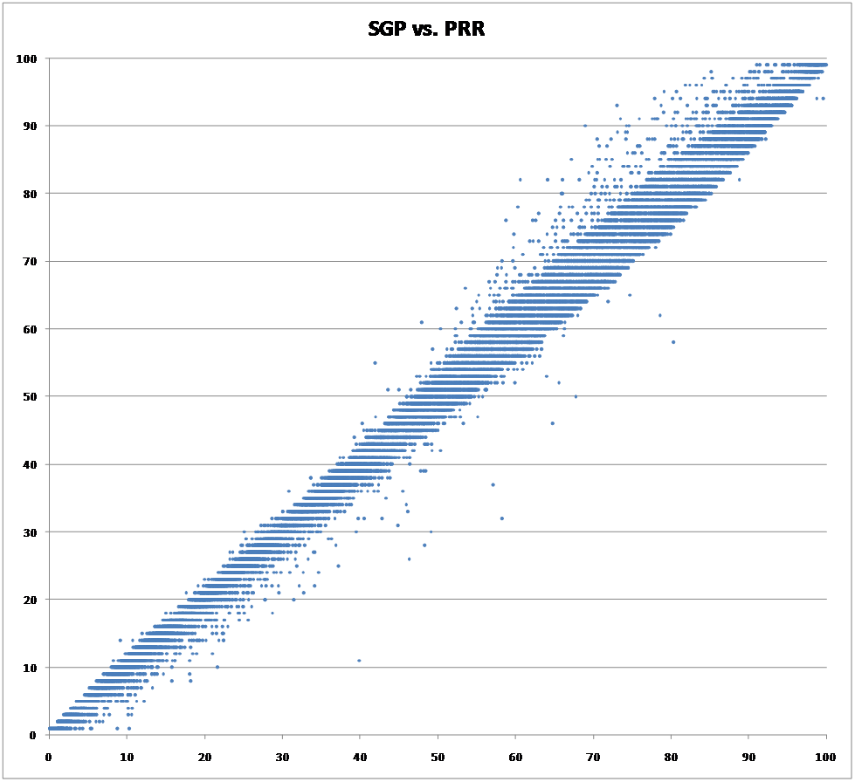
Is anything really new here?
Thanks to Andrew Ho and Katherine Furgol for this graphic
Notes:
However, even though the statistics are a little different, for purposes of teacher value-added modeling, the SGPs have almost exactly the same limitations as more familiar regression models.
This scatterplot used a 4-year longitudinal dataset, applying Betebenner’s method to construct SGPs, which are plotted against percentile ranks of residuals from an OLS regression. Correlation is .996; even higher (.997) when the corresponding analysis is performed using only a single prior year of data.
What this graphic shows is that SGPs are just scaling those residuals, the differences between students observed and predicted test scores, a little differently.

Slide 26
Examining the Evidence
Stability of “effectiveness” estimates
  That first “simplified assumption”
Problems with the tests
  That second “simplified assumption”
Strongly Ignorable Treatment Assignment
Professional consensus
Notes:
Up until now, I’ve described the problem and raised some questions. Next, I’d like to turn to some studies that can show us whether the problems I’ve mentioned are serious or not.
My first “simplified assumption” pertained to the notion that “teacher effectiveness” is a stable construct. That is addressed by evidence concerning the stability of effectiveness estimates.
My second “simplified assumption” had to do with the power of brief, inexpensive tests to locate students along a unidimensional achievement continuum. Since test scores are the fundamental drivers of the whole system, it’s important to look at them closely.
The third bullet here, “Strongly Ignorable Treatment Assignment,” refers to one of the assumptions I mentioned earlier. Stated simply, because random assignment of students to teachers is impossible, the model has to include enough information about students so that once that information is accounted for, student assignment to teachers is unrelated to potential outcomes.
Finally, I’ve included a few quotes, taken from the EPI Brief.

Slide 27
Examining the Evidence
Stability of “effectiveness” estimates
  That first “simplified assumption”
Problems with the tests
  That second “simplified assumption”
Strongly Ignorable Treatment Assignment
Professional consensus
Notes:
Let’s turn to the first of these topics, concerning the stability of effectiveness estimates.

Slide 28
Stability of “Effectiveness” Estimates
Newton, Darling-Hammond, Haertel, & Thomas (2010) compared high school math and ELA teachers’ VAM scores across
  Statistical models
  Courses taught
  Years
Full report at http://epaa.asu.edu/ojs/article/view/810
Notes:
This question asks whether VA model estimates are reliable. It’s sometimes said that unreliability in the middle of the scale doesn’t matter because we’re interested in identifying extreme cases, but in fact, research shows that these VA model estimates are, if anything, less accurate for teachers in the tails of the distribution.
Berkeley Professor Xiaoxia Newton, And Stanford Professors Linda Darling-Hammond, Ewart Thomas, and I looked at this question in a paper published last year, using a large dataset constructed for another project. We compared teachers’ value-added scores from different courses, from the same course taught two successive years, and across different VAM specifications.

Slide 29
Findings from Newton, et al.
Sample* for Math and ELA VAM Analyses
Academic Year | 2005-06 | 2006-07
Math teachers | 57 | 46
ELA teachers | 51 | 63
Students Grade 9 Grade 10 Grade 11 | 646 714 511 | 881 693 789
*Sample included all teachers who taught multiple courses. Ns in table are for teachers x courses. There were 13 math teachers for 2005-06 and 10 for 2006-07. There were 16 ELA teachers for 2005-06 and 15 for 2006-07.
Notes:
This slide gives you some sense of the size of the study. The numbers in the top half of the table, 57, 46, 51, and 63, are counts of the numbers of separate VAM estimates we were able to calculate. These included multiple estimates for the numbers of math and English Language Arts teachers shown in the note at the bottom.

Slide 30
% of Teachers Whose Effectiveness Ratings Change …
 | By at least 1 decile | By at least 2 deciles | By at least 3 deciles
Across models* | 56-80% | 12-33% | 0-14%
Across courses* | 85-100% | 54-92% | 39-54%
Across years* | 74-93% | 45-63% | 19-41%
*Depending on the model
Notes:
This slide shows how much teacher effectiveness estimates bounced around. From these numbers, we concluded that any simple notion of “effectiveness” as an enduring quality of individual teachers is deeply problematical.
You’ll note that we divided teachers into ten decile bands for purposes of comparison. You may recall that Richard Buddin analyzed data on teachers in the LA Unified School District, and effectiveness ratings for thousands of teachers were published by the LA Times. The LA Times used five effectiveness categories, which is a courser breakdown than our 10 decile categories. Derek Briggs and Ben Domingue reanalyzed the same data as Buddin, using an alternative model that added controls for (1) a longer history of a student’s test performance, (2) peer influence, and (3) school-level factors. They found that under their alternative specification, effectiveness classifications for reading would change for more than half the teachers, and classifications for mathematics would change for almost 40 percent of the teachers. So, the Briggs and Domingue findings are quite consistent with the results in the first row of our table here. They have not published any analyses concerning stability across courses or across years.

Slide 31
One Extreme Case:
An English language arts teacher
Comprehensive high school
Not a beginning teacher
White
Teaching English I
Estimates control for:
  Prior achievement
  Demographics
  School fixed effect
Notes:
This is a particularly dramatic case from the Newton, et al. study, showing how an experienced high school teacher received wildly different effectiveness ratings teaching the same course to two groups of students, even with statistical controls for school, prior student achievement, and student demographics. The Year 1 class included higher proportions of low-income, Hispanic, and English Learner students. With that class, the teacher’s effectiveness was at the bottom of the distribution. The next year, with a different class, it was at the top.

Slide 32
Teacher “effectiveness” bounces around from one year to the next
Value-added estimates are extremely noisy.
Consider classification of teachers into 5 categories (A-F) in two consecutive years.
Grade in first year:
Grade in second year:
A
A
B
C
D
F
F
A
B
C
D
F
Average across 5 Florida districts. Grades A-F correspond to quintiles 1-5. Source: Sass (2008).
Thanks to Jesse Rothstein for the original version of this slide.
32
Notes:
The results from our small study are consistent with those found in much larger studies elsewhere. Tim Sass published an analysis of teacher effectiveness data from five districts in Florida. Under the Florida system, teachers receive grades from “A” to “F.” Sass compared teachers’ grades from one year to the next, and the results were as shown on this slide.

Slide 33
Many teachers indicated as effective or ineffective in one year are not for others
27% of “A” teachers one year get D or F next year. 45% get C or lower.
30% of “F” teachers one year get A or B next year. 51% get C or better.
Grade in first year:
Grade in second year:
A
A
B
C
D
F
F
A
B
C
D
F
Average across 5 Florida districts. Grades A-F correspond to quintiles 1-5. Source: Sass (2008).
Thanks to Jesse Rothstein for the original version of this slide.
33
33
Notes:
We think of grades as being fairly stable over time, but here, a quarter of the teachers at the top of the distribution one year were found to be close to the bottom the next year, and almost a third of those at the bottom one year were at or near the top the following year.

Slide 34
Examining the Evidence
Stability of “effectiveness” estimates
  That first “simplified assumption”
Problems with the tests
  That second “simplified assumption”
Strongly Ignorable Treatment Assignment
Professional consensus
Notes:
The second topic I’d like to turn to is the tests themselves. I’d like to show you just five released items from the California Standards Tests, from 7th grade history, 11th grade history, 9th grade English, Algebra I, and Biology. Before each item, I’ll show you the standard it’s supposed to measure.

Slide 35
7th Grade History /
Social Studies
WH7.8.5.
Detail advances made in literature, the arts, science, mathematics, cartography, engineering, and the understanding of human anatomy and astronomy (e.g., by Dante Alighieri, Leonardo da Vinci, Michelangelo di Buonarroti Simoni, Johann Gutenberg, William Shakespeare).
Notes:
Here’s the first standard. Students are to “Detail advances made” in various areas, by various historical figures.

Slide 36
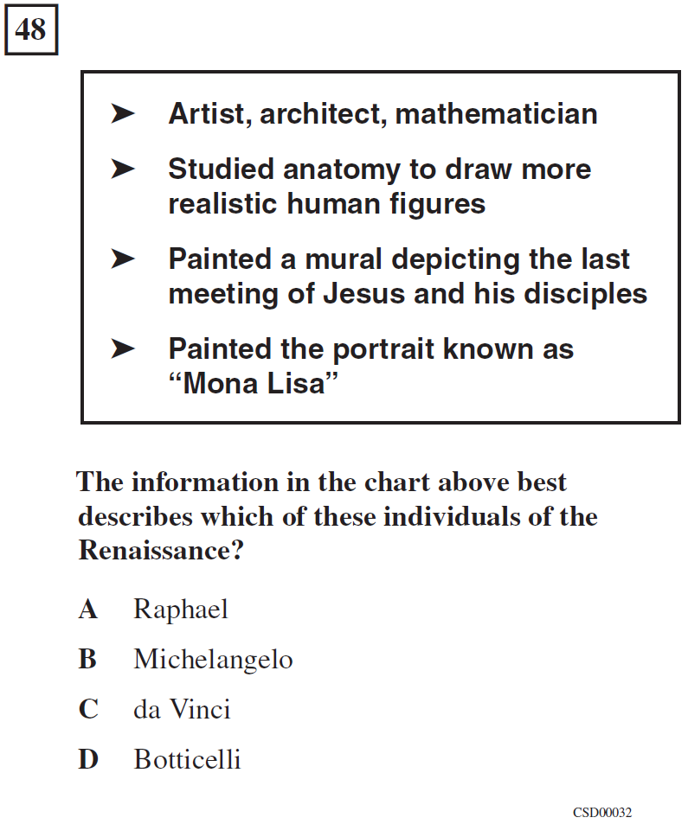
Item Testing WH7.8.5
Notes:
Well, the standard said, “Detail advances made …” and these are certainly details. Let me click through a few more examples.

Slide 37
11th Grade History/
Social Studies
US11.11.2.
Discuss the significant domestic policy speeches of Truman, Eisenhower, Kennedy, Johnson, Nixon, Carter, Reagan, Bush, and Clinton (e.g., education, civil rights, economic policy, environmental policy).
Notes:
Here’s a U.S. History standard. There’s a lot to be said about just this one slide, the way it packs so many details into one complicated sentence, but for now just notice the verb “discuss.”

Slide 38
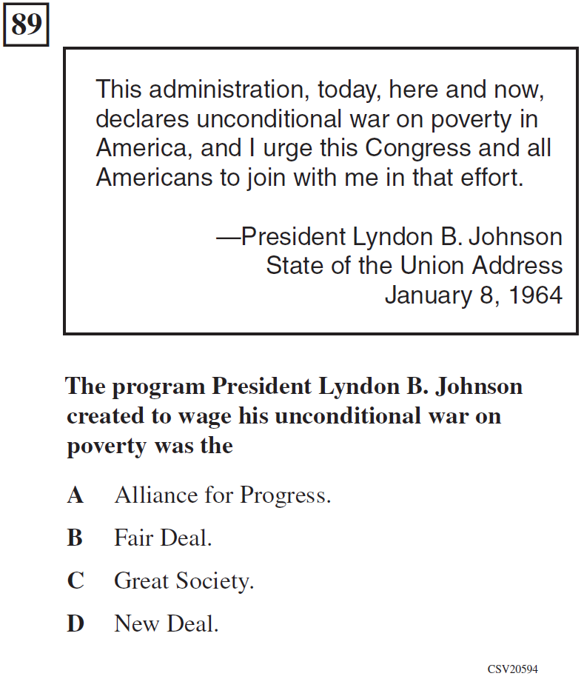
Item Testing US11.11.2
Notes:
No discussion, just matching a program title to a president. The stimulus quote looks good, but you don’t even have to read it to answer the item.

Slide 39
9th Grade English-
Language Arts
9RC2.8
Expository Critique: Evaluate the credibility of an author’s argument or defense of a claim by critiquing the relationship between generalizations and evidence, the comprehensiveness of evidence, and the way in which the author’s intent affects the structure and tone of the text (e.g., in professional journals, editorials, political speeches, primary source material).
Notes:
Here’s an English Language Arts objective. Let’s see how the state test measures “Expository Critique.”

Slide 40

Item Testing 9RC2.8
Notes:
I’m not showing you the reading passage, but you don’t really need it. The evidence from the text appears in response option C, and the generalization appears in the question stem. [click]

Slide 41
Algebra I
25.1
Students use properties of numbers to construct simple, valid arguments (direct and indirect) for, or formulate counterexamples to, claimed assertions.
Notes:
Since these are multiple-choice items, you know students won’t be constructing or formulating anything…

Slide 42
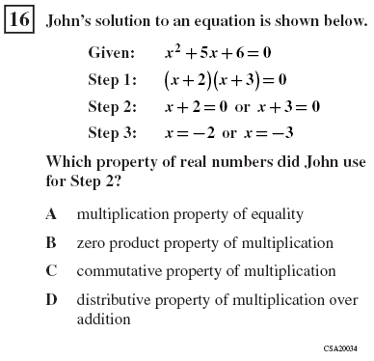
Item Testing 25.1
Notes:
But in fact, all that’s required, once again, is to pick the right label. Naming the procedure is not the same thing as doing the math.

Slide 43
High School Biology
BI6.f
Students know at each link in a food web some energy is stored in newly made structures but much energy is dissipated into the environment as heat. This dissipation may be represented in an energy pyramid.
Notes:
Here, the key ideas seem to be storage and dissipation of energy. Let’s see how that’s tested.

Slide 44
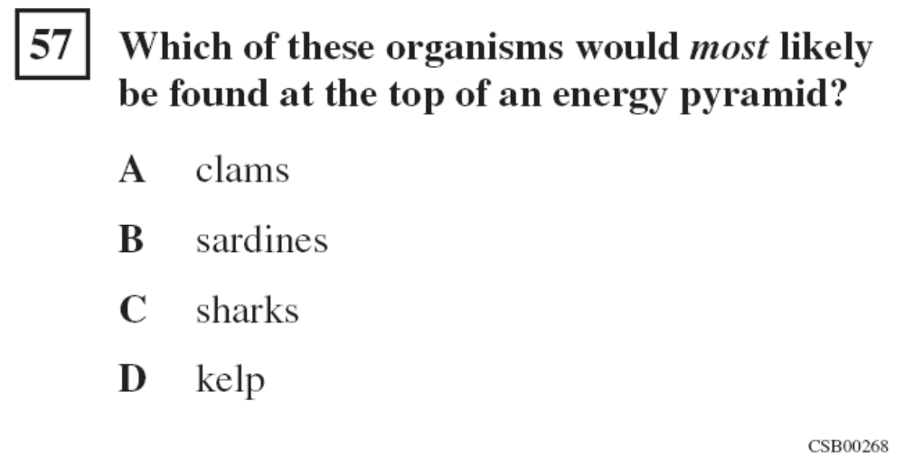
Item Testing BI6.f
Notes:
Well, it looks like an energy pyramid is a lot like a food chain.
The point of these examples is not to argue that we need tougher tests. A lot of smart people worked very hard to build the tests we have, and many committees reviewed and approved them. You can see how each of these items connects to some small piece of its associated objective.

Slide 45
Problems With Tests Will Persist
PARCC and SBAC assessments aligned to the CCSS should be better than most existing state assessments, but not good enough to solve these problems
  Content standards are not all to blame
  Testing limitations arise due to
  (1) costs of some alternative item formats;
  (2) inevitable differences between teaching to the test and teaching to the standards;
  (3) technical challenges in measuring some key skills
Notes:
I’m almost afraid to show these slides, because the automatic response so often is, “We need better tests.” Calling for better tests won’t help. That’s been tried, again and again. There’s room for improvement, of course, and the SMARTER Balanced tests, as well as the PARCC tests, should be better than what we have now. But they're not going to be good enough to turn "scoring high" on these tests into the de facto goal of schooling. My message here is that attaching even higher stakes to tests like these is going to drive curriculum and instruction further in the wrong direction. If “teacher effectiveness” means improving performance on items like these, then the accountability system may reward the wrong people for doing the wrong things. 2010 data from the Bill & Melinda Gates Foundation indicate that 20%-30% of teachers in top quartile when effectiveness is measured using state assessmens are in bottom half when effectiveness is measured using more conceptually demanding tests (and vice versa). RAND researchers have found that teachers’ effectiveness estimates are very different using “procedures” versus “problem solving” subscales of the same math test.

Slide 46
Examining the Evidence
Stability of “effectiveness” estimates
  That first “simplified assumption”
Problems with the tests
  That second “simplified assumption”
Strongly Ignorable Treatment Assignment
Professional consensus
Notes:
As I said earlier, strongly ignorable assignment of students to teachers is a crucial assumption in value-added models. Depending on the precise model and the intended interpretations of VAM estimates, a corresponding assumption may be required concerning the assignment of teachers to schools. These assumptions matter because there will always be omitted variables. Random assignment conditional on variables included in the model would assure that effectiveness estimates were unbiased even if the model failed to control for all achievement influences outside the teachers’ control.

Slide 47
Student Assignments Affected By
Student ability grouping (tracking)
Teachers’ particular specialties
Children’s particular requirements
Parents’ requests
Principals' judgments
Need to separate children who do not get along
Notes:
The processes by which students are assigned to teachers are not well documented, but in a 2010 paper, Jesse Rothstein suggests that anecdotally, some of these factors may influence such assignments.

Slide 48
Teacher Assignments Affected By
Differential salaries / working conditions
Seniority / experience
Match to school’s culture and practices
Residential preferences
Teachers’ particular specialties
Children’s particular requirements
Notes:
There is much better documentation of the nonrandom assignment of teachers to schools.

Slide 49
Does Non-Random Assignment Matter? A falsification test
Logically, future teachers cannot influence past achievement
Thus, if a model predicts significant effects of current-year teachers on prior-year test scores, then it is flawed or based on flawed assumptions
Notes:
In his 2010 paper, Rothstein develops a falsification test to see how important violations of the random assignment assumption turn out to be. The idea is simple and elegant. He looks to see if the model predicts teacher effects running backwards in time. If it does, then there’s a problem.

Slide 50
Falsification Test Findings
Rothstein (2010) examined three VAM specifications using a large data set and found “large ‘effects’ of fifth grade teachers on fourth grade test score gains.”
  In addition to North Carolina, similar results have been found in Texas and Florida, as well as in San Diego and in New York City
Notes:
Rothstein used data from fifth-grade classrooms in North Carolina from the 2000-2001 school year. His sample included over 60,000 students in over 3,000 classrooms in 868 schools. He used a variety of value-added models, and consistently found that fifth-grade teacher assignments showed powerful effects on fourth-grade test score gains. His paper explains in detail how this shows that omitted variables and nonrandom assignment together introduce serious bias in teacher’s effectiveness estimates. As Rothstein says, “VA rewards or penalizes teachers for the kids they teach, not just for how well they do it.”

Slide 51
Falsification Test Findings
Briggs & Domingue (2011) applied Rothstein’s test to LAUSD teacher data analyzed by Richard Buddin for the LA Times
  For Reading, ‘effects’ from next year’s teachers were about the same as from this year’s teachers
  For Math, ‘effects’ from next year’s teachers were about 2/3 to 3/4 as large as from this year’s teachers
Notes:
In their reanalysis of the LAUSD data, Briggs and Domingue used Rothstein’s test. This falsification test was not included in Richard Buddin’s original paper. In one comparison, they found that the estimated effects of fourth-grade teachers on students’ third-grade reading gains were slightly larger than the estimated effects of fourth-grade teachers on students’ fourth-grade reading gains.

Slide 52
Examining the Evidence
Stability of “effectiveness” estimates
  That first “simplified assumption”
Problems with the tests
  That second “simplified assumption”
Strongly Ignorable Treatment Assignment
Professional consensus
Notes:
On my next slides I have just three quotations from the EPI Briefing Paper. I agree with these quotes, but I want to acknowledge here that the field is not unanimous on these questions, and some respected methodologists go further than others in supporting value-added modeling for teacher evaluation.

Slide 53
Professional Consensus
We do not think that their analyses are estimating causal quantities, except under extreme and unrealistic assumptions.
– Donald Rubin
Notes:
In a 2004 paper in a special issue of the Journal of Educational and Behavioral Statistics, Rubin, Stuart, and Zanutto reached this conclusion. A common dodge is to say that these models are merely descriptive. But if stakes for teachers are attached to the results, then it‘s cold comfort to say the model is descriptive and causal attributions aren‘t intended.

Slide 54
Professional Consensus
The research base is currently insufficient to support the use of VAM for high-stakes decisions about individual teachers or schools.
– Researchers from RAND Corp.
Notes:
In a 2003 RAND research report, McCaffrey, Koretz, Lockwood, and Hamilton had this to say.

Slide 55
Professional Consensus
VAM estimates of teacher effectiveness that are based on data for a single class of students should not used to make operational decisions because such estimates are far too unstable to be considered fair or reliable.
– 2009 Letter Report from the
Board on Testing and Assessment,
National Research Council
Notes:
In 2009, the NRC’s Board on Testing and Assessment issued a letter report directed to Education Secretary Arne Duncan, commenting on the Department’s proposal on the Race to the Top Fund. That letter included strong cautions concerning value-added models, and strongly urged further research and pilot studies before mandating any operational use of these models. I should mention here that I chair the Board on Testing and Assessment. The National Research Council’s review process really does keep us from going beyond the evidence when we make statements like this.

Slide 56
Unintended Effects
Narrowing of curriculum and instruction
  What doesn’t get tested doesn’t get taught
Instructional focus on students expected to make the largest or most rapid gains
  Student winners and losers will depend on details of the model used
Erosion of teacher collegial support and cooperation
Notes:
In closing, I’ll just quickly point to some likely unintended consequences if high-stakes teacher evaluations based on student test scores are implemented thoughtlessly. These include a narrowing of what is taught to just that which is tested, targeting of instructional resources toward those students most likely to make rapid gains, and competition among teachers instead of mutual support and collaboration.

Slide 57
Valid and Invalid Uses
VALID
  Low-stakes
  Aggregate-level interpretations
  Background factors as similar as possible across groups compared
INVALID
  High-stakes, individual-level decisions, comparisons across highly dissimilar schools or student populations
Notes:
Teacher effectiveness estimates with statistical controls for prior achievement are better than estimates based on unadjusted end-of-year student test scores, and these models may be of real value if used appropriately, but they are not magic, and I believe they have been seriously oversold.

Slide 58
Unintended Effects
“The most pernicious effect of these [test-based accountability] systems is to cause teachers to resent the children who don’t score well.”
—Anonymous teacher,
in a workshop many years ago
Notes:
I can still hear a teacher I met over 20 years ago saying these words. I have a great fear that thoughtless implementation of score-based teacher evaluation models may undermine the education of our most vulnerable children.

Slide 59
Thank you
This PowerPoint will soon be available at http://www.stanford.edu/~haertel, under “Selected Presentations”

